Slide 1

Serverless Image Recognition Application on AWS

Slide 2
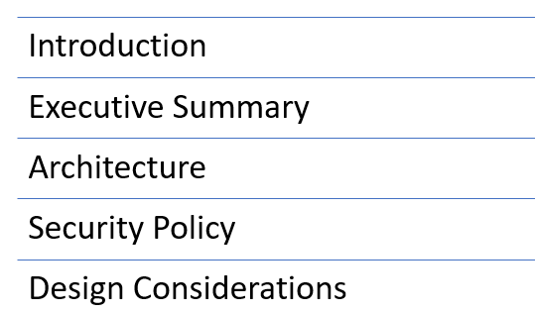
Agenda
Team # 3
Team Members :
1) Rahul Sinha
2) Soumitra Mishra

Slide 3

Introduction
Problem Statement:
Automate and innovate the inspection process of a widget manufacturing company that currently take pictures of manufactured widget and inspect it manually to ensure the compliance standards set by QA group.
Proposed Solution:
Create an AWS serverless architecture to fully automate the manual inspection process.
Create an event-based architecture and make use of Amazon Rekognition to inspect and generated reports for the widget images stored in the cloud

Slide 4
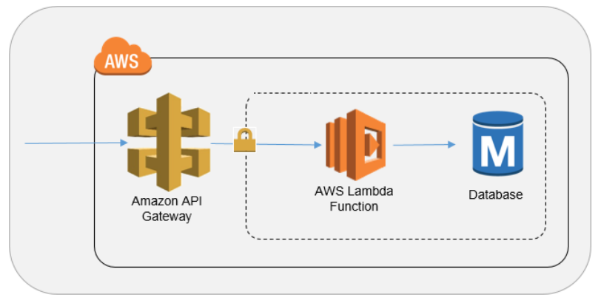
Architecture -Design Summary
3 tier serverless Architecture
API Gateway to accept the API calls to upload images from the application.
AWS Lambda as the business logic tier
AWS S3 as the data tier to store original/inspected widget images

Slide 5










Architecture Diagram: AWS Components
AWS Cloud
Read/Put widget images
Send JSON Requests
Amazon Simple Storage Service (S3)
AWS Lambda
Lambda
Execution
Logs
Send
email
Reports
Client
Amazon API Gateway
Amazon Simple
Notification Service
Amazon CloudWatch
Amazon Rekognition

Slide 6
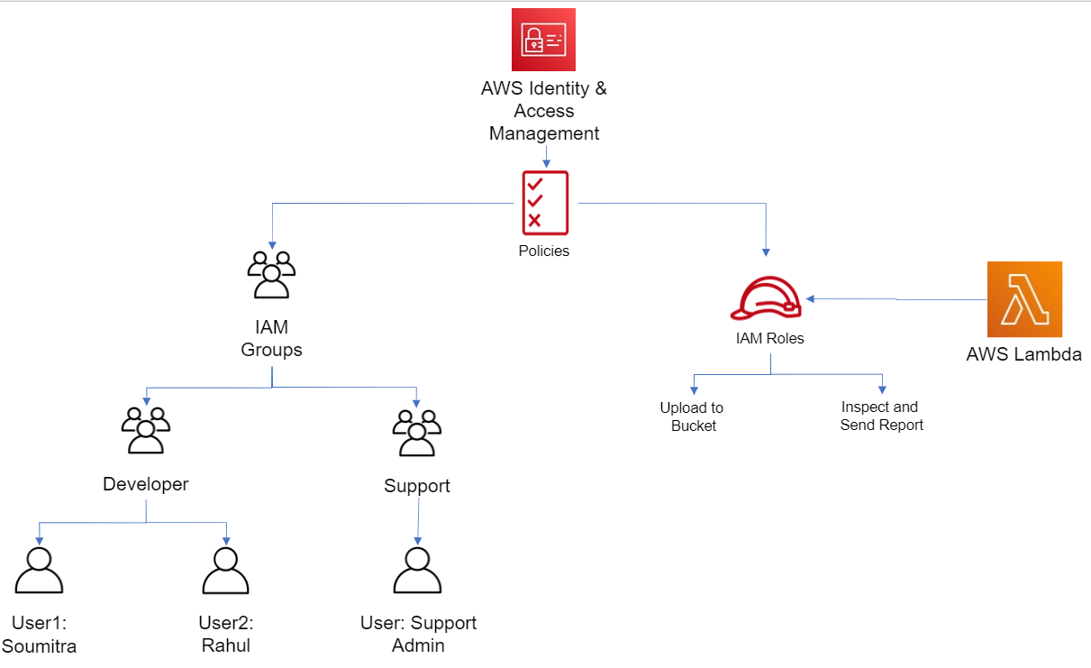
Architecture : IAM Detail

Slide 7
Architecture Diagram : Component Summary
Amazon API gateway acts as a reverse proxy to accept all application programming interface (API) calls .
AWS Lambda lets us run Python codes when events are triggered without provisioning or managing servers.
AWS Lambda interacts with other services to provide application functionalities.
Amazon Simple Storage Service (Amazon S3) is an object storage service which is used in our application to store the original as well as the inspected widget images.
AWS SNS used to send widget inspection reports to the Quality control group via Lambda.
AWS Rekognition : Uses machine learning to inspect widget images and generate a detailed report
AWS Cloudwatch : CloudWatch provides us with data and actionable insights to monitor the applications, respond to system-wide performance changes, optimize resource utilization, and get a unified view of operational health
.

Slide 8
Design Considerations
Created a new policy to allow the required AWS services access to Lambda functions (AWS S3, Rekognition, SNS)
Created a quality control group for the support staff to monitor the health of the application.
Designed the application with the AWS well architected framework policies to ensure reliability and running workloads on the cloud
Limited access provided to Lambda functions using IAM policy to only be able to the required services.

Slide 9
Thank you

